Slide 1
Comparing a Field (XRF) versus a Laboratory Method (ICP-MS) to Quantify four metals in Arizona Residential Soils
By Allison Segapeli
4/18/2020

Slide 2
Introduction
The goal was to determine whether a field portable X-Ray Fluorescence spectrograph (XRF) could be used to measure the concentrations of three metals and one metalloid in the field with the same levels of precision and accuracy as the laboratory-based acid digestion plus Inductive Coupled-Mass Spectrometry (ICP-MS)
Notes:
Explain difference between yard and garden verbally

Slide 3
Methods
Yard and Garden soil samples collected by community members in residential areas were analyzed by both XRF and IPC-MS
The results of the XRF and IPC-MS were compared using:
Data from all soil samples
Then split into two categories: Yard and Garden Soils

Slide 4
Methods
Validation Process
Five metal(loid)s of interest were analyzed
Linear regression was used to infer relationship between XRF and ICP-MS

Slide 5
Methods Soil Sample Preparation & Analyses All soils were Air-dried, sieved and ball milled
ICP-MS
Acid digestion
ICP-MS mass spec analysis was done
XRF
Scans were done with samples being one inch thick
Each sample was scanned three times.

Slide 6
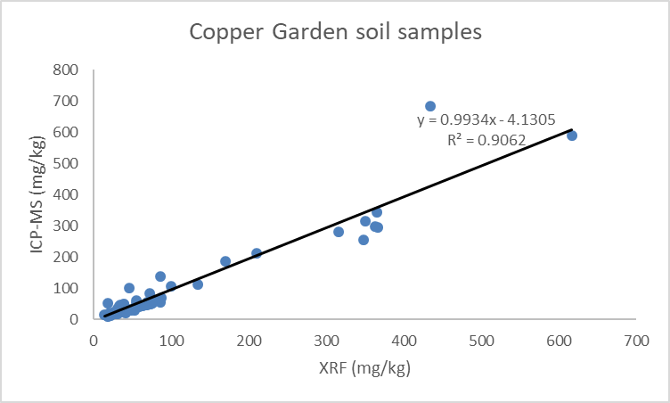
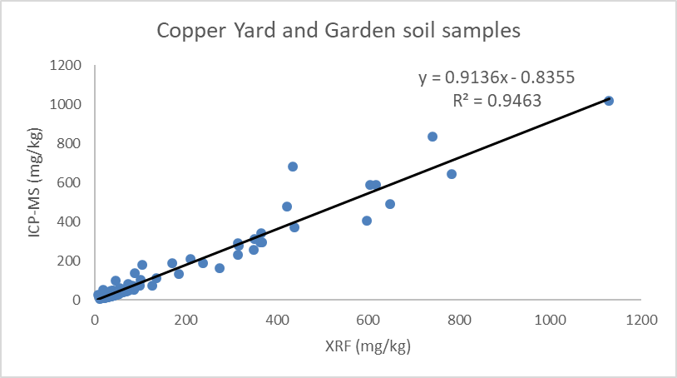
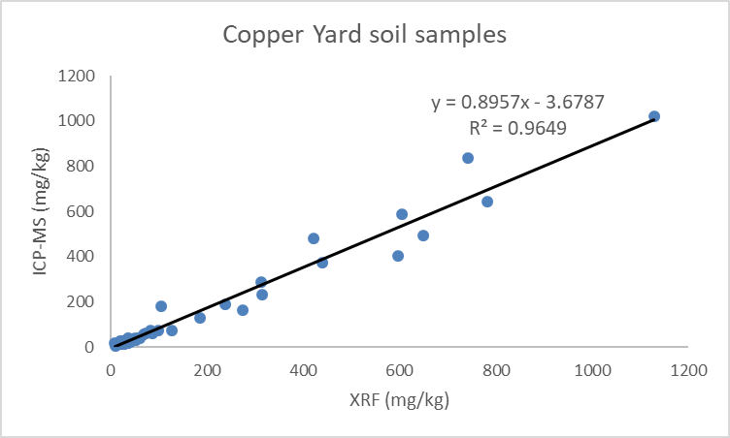
n=63
n=124
n=57

Slide 7
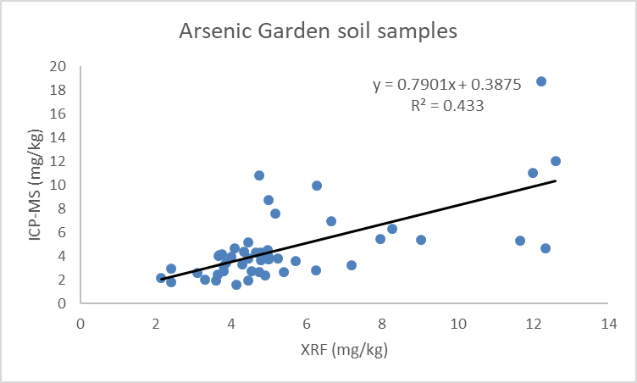
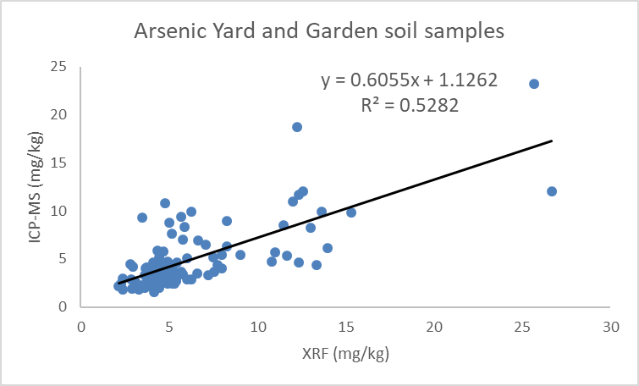
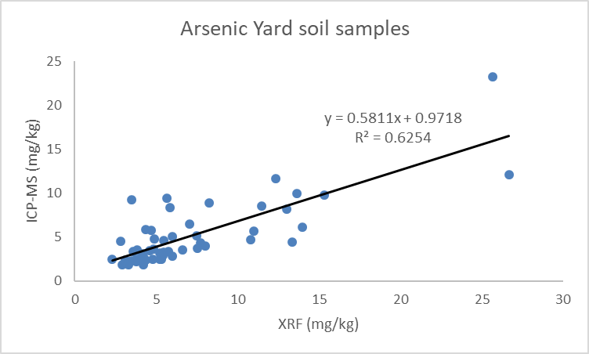
n=49
n=104
n=51

Slide 8
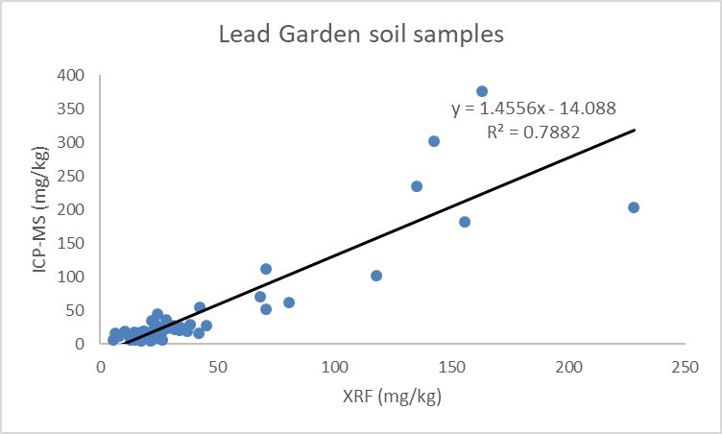
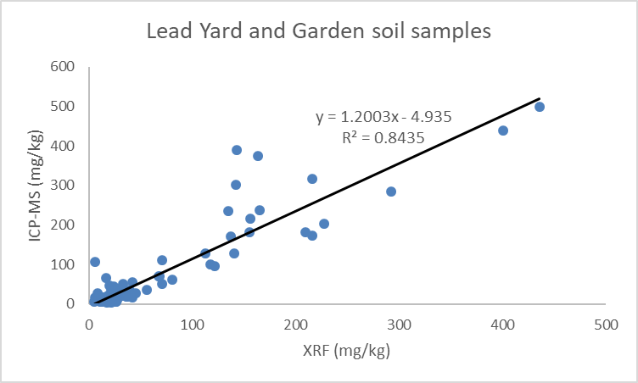
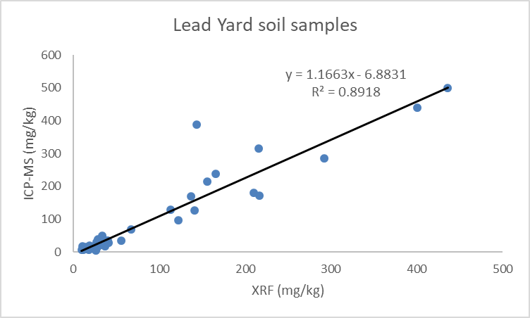
n=63
n=124
n=57

Slide 9
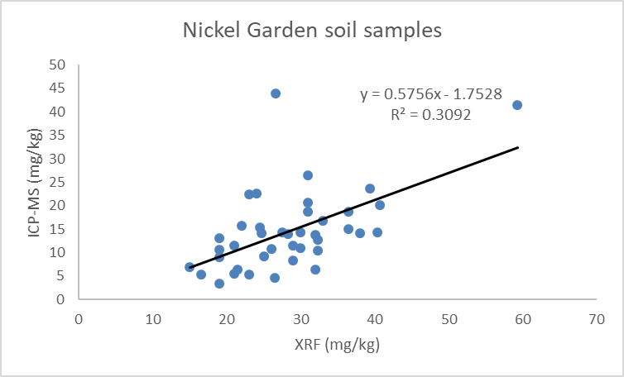
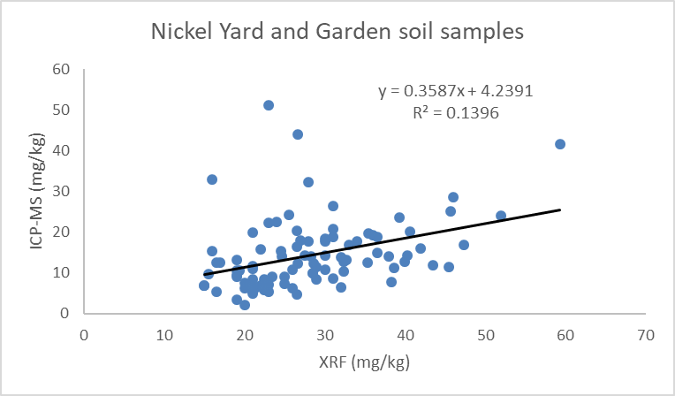
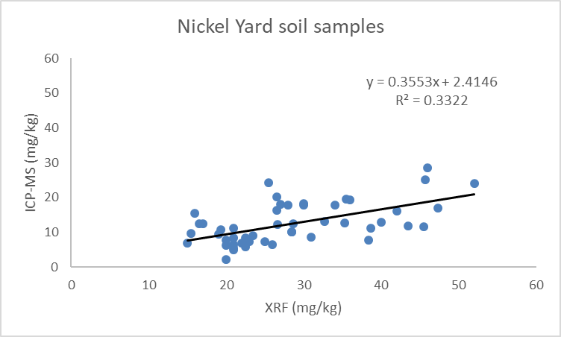
n=40
n=93
n=49

Slide 10
Results
Copper and Lead displayed the best correlation between the ICP-MS and XRF, with R² of 0.9463 and 0.8435 respectively
All the elements showed better correlation in the yard samples than the garden samples, presumably due to less soil organic matter

Slide 11
Conclusions
Preliminary regression analysis indicates that Field Portable X-Ray Fluorescence may be used to quickly measure Cu and Pb in soild when levels are below or near the Arizona Soil Contaminations Standards
Additional statistical analysis is needed to determine the level of significance of these results.
The presence of soil organic matter (SOM), typically higher in home gardens than in yard soils, may have lowered the accuracy and precision of the Portable X-Ray Fluorescence measurements.
Additional chemical analyses of the soil samples are needed to verify this hypothesis
Other soil variables besides SOM (to be determined) may help explain the different correlations between yard and garden soils.

Slide 12
Additional Notes.
Most samples were either below or close to Arizona Soil Contamination Standards
Cadmium data was not presented, most of the measure values were below XRF or ICP-MS instrument-method quantification detection limits

Slide 13
Next Steps
A further analysis into the effects of organic material, should be done by analyzing samples with known amounts of organic material added
Samples of higher concentrations should be analyzed to test the capabilities of the XRF
Additional statistical analysis is needed to determine the level of significance of these results

Slide 14
Thank you very Much!
Dr. Monica Ramirez-Andreotta
Dr. Janick F. Artiola
https://gardenroots.arizona.edu/

